Slide 1
AI Agent for Digital Financial Literacy Using rag
CAPSTONE PROJECT
Presented By:
Arya Das – Haldia Institute Of Technology – cse (ds)

Slide 2
OUTLINE
Problem Statement
Proposed System/Solution
System Development Approach
Algorithm & Deployment
Result (Output Image)
Conclusion
Future Scope
References

Slide 3
Problem Statement
Many users, especially those from non-technical or underserved backgrounds, struggle to understand and navigate essential financial tools and practices. This lack of understanding leads to poor financial decisions, increased risk of fraud, and missed opportunities for economic empowerment.
Even when users are motivated to learn, they face barriers such as: Language and Literacy Gaps, Fragmented Information Sources and Lack of Personalization. These limitations hinder financial inclusion, leaving large segments of the population underserved and economically vulnerable.

Slide 4
Proposed Solution
Develop an AI Agent for Digital Financial Literacy, powered by RAG (Retrieval-Augmented Generation), helps users understand and navigate essential financial tools and practices. It retrieves reliable content on using UPI, avoiding online scams, understanding interest rates, budgeting, and personal finance management from government portals, banking websites, and educational platforms.
Capabilities:
Retrieves content from trusted sources (e.g., government portals, banking websites, educational platforms).
Supports multilingual interaction for diverse users.
ensures financial literacy is accessible, personalized, and culturally inclusive.
empowers users with knowledge, protects them from fraud, and builds confidence in digital finance.

Slide 5
System Approach
The "System Approach" section outlines the overall strategy and methodology for developing and implementing the rental bike prediction system. Here's a suggested structure for this section:
System requirements:
IBM Cloud (mandatory)
IBM Watsonx.ai for Generative AI and Machine Learning
IBM Granite for building AI-driven chats
IBM cloud object storage for handling deployment space

Slide 6
Algorithm & Deployment
Model Selection:
IBM Granite for understanding and generating natural language responses.
Data Processing:
AI Agent automates the tasks.
RAG for retrieval and response generation.
Deployment:
IBM Cloud Lite Services for hosting and data management.

Slide 7
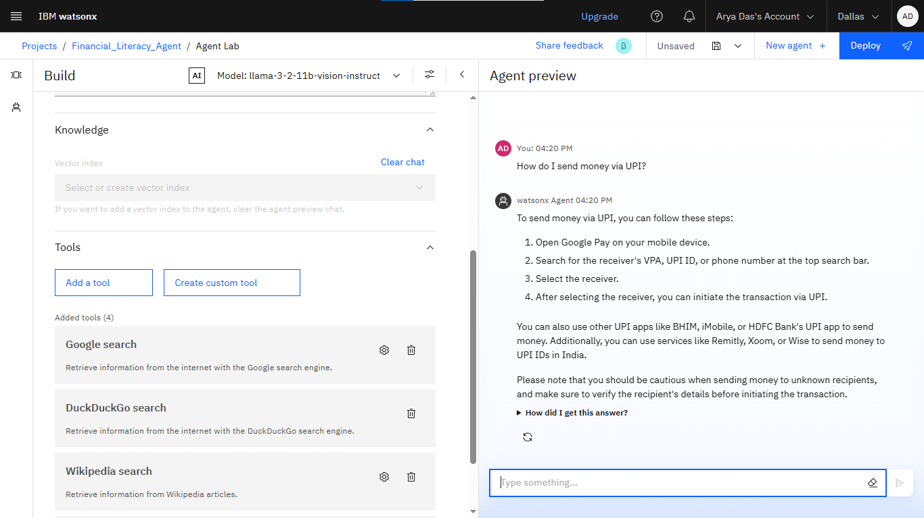
Result

Slide 8
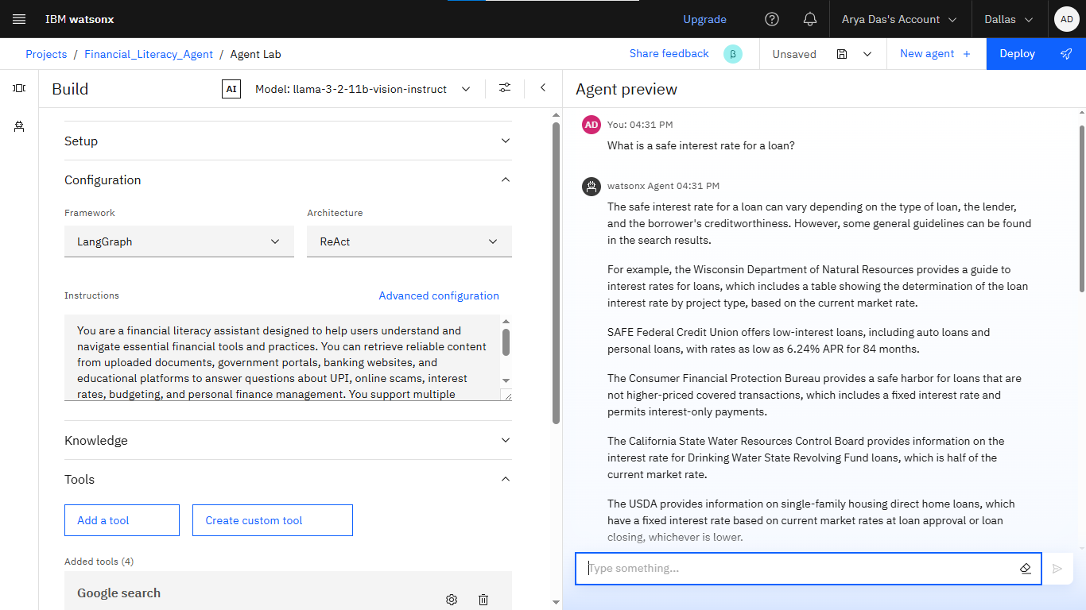
Result

Slide 9
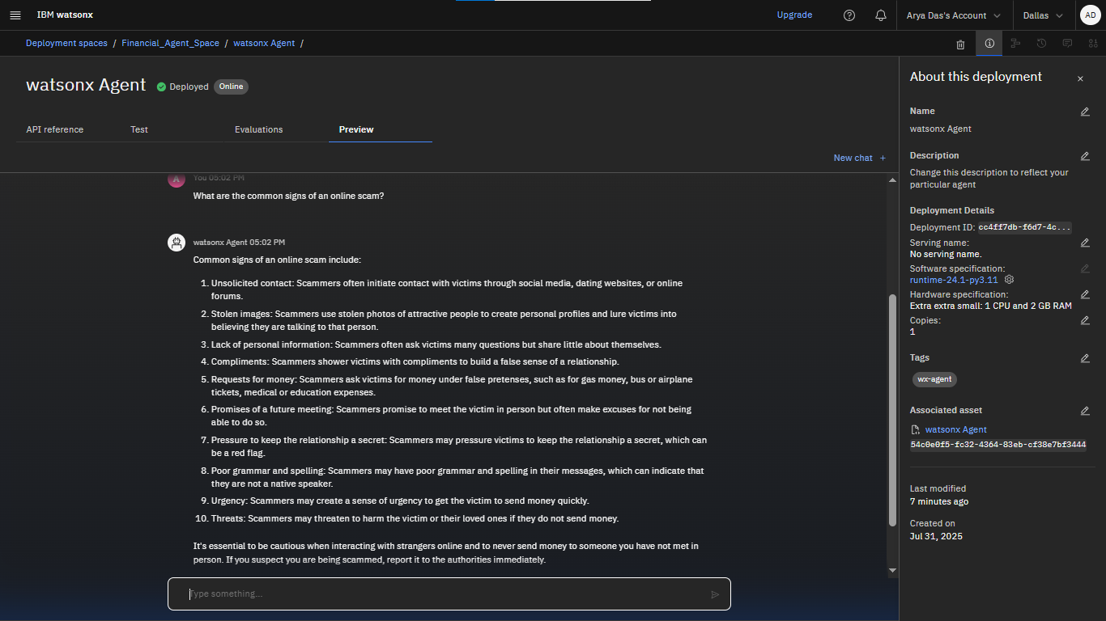
Result

Slide 10
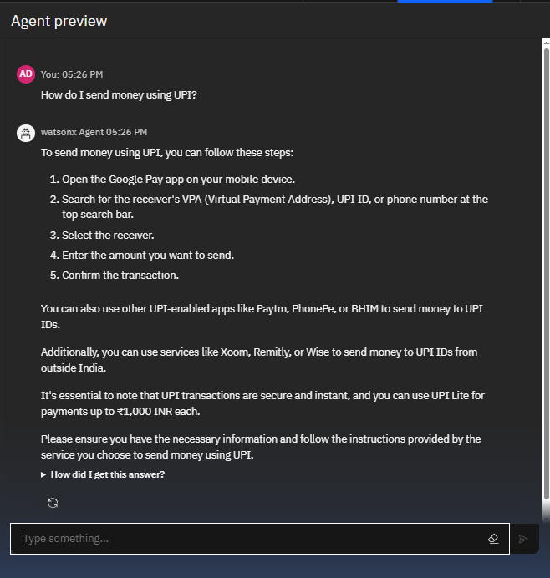
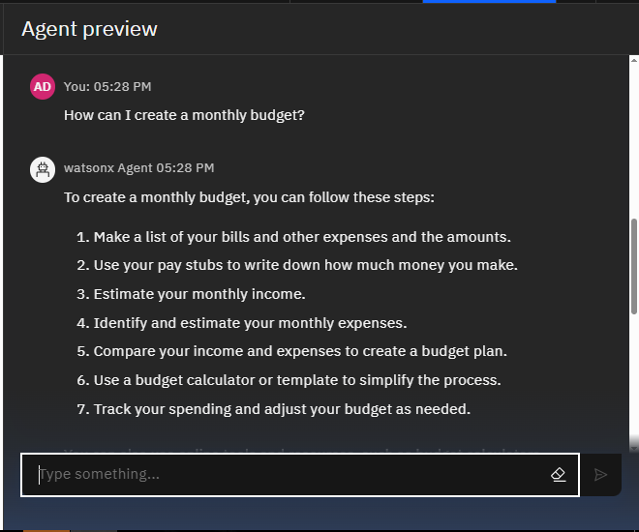
Result

Slide 11
Conclusion
Key Points:
Bridges the gap in digital financial literacy with an AI-driven, inclusive solution.
Leverages IBM Cloud and Granite for reliability and scalability.
Impact:
Empowers users with knowledge.
Protects against fraud.
Boosts confidence in digital finance.

Slide 12
Future scope
Enhancements:
Add real-time financial data (e.g., live interest rates).
Expand language support for more regions.
Introduce voice interaction for accessibility.
Opportunities:
Collaborate with banks for tailored advice.
Create educational modules for deeper learning.

Slide 13
References
IBM Cloud Lite Services Documentation
IBM Granite Model Overview
Government Financial Literacy Portals

Slide 14
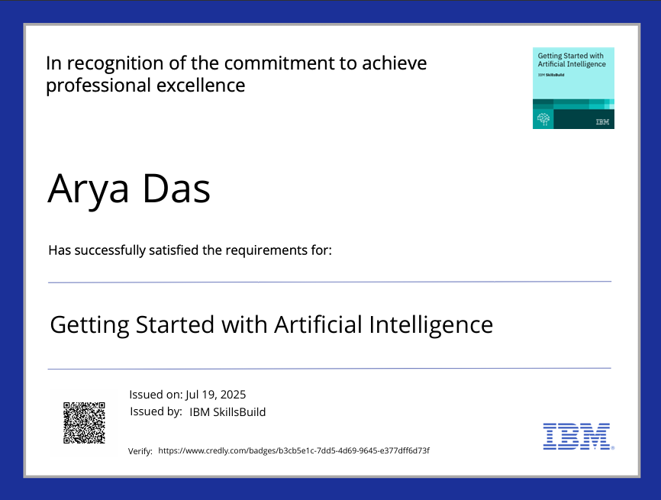
IBM Certifications

Slide 15
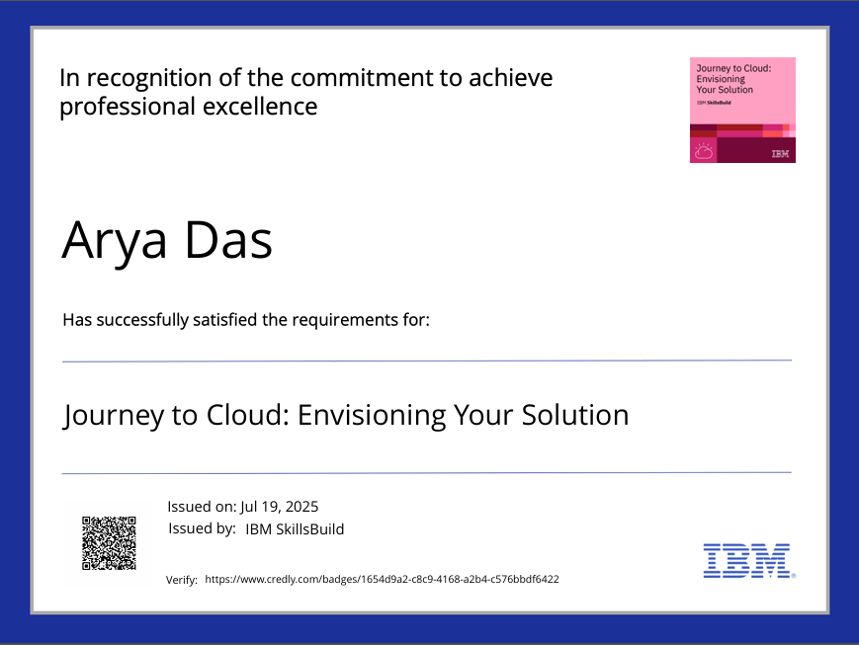
IBM Certifications

Slide 16
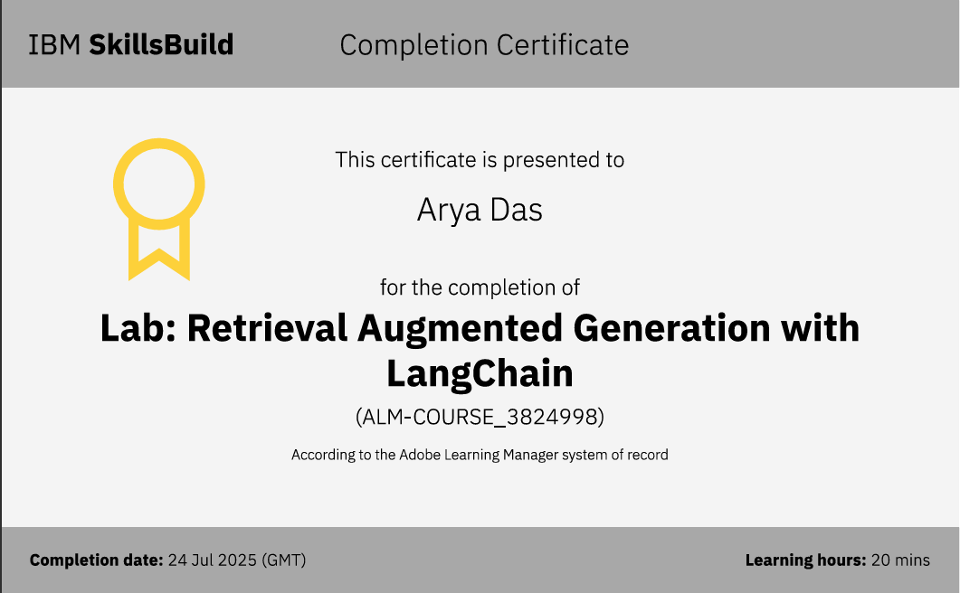
IBM Certifications

Slide 17
THANK YOU

